Slide 1
Electron and why you should care
Notes:
Electron actually straightforward

Slide 2
Agenda
What is Electron?
Example applications on the market
Why should you care
Electron pro’s and cons
Setting up Electron
Languages
Backend options
TS/JS
C#
Java
Debugging
Testing
Our experience with Electron and using it
“Hastings Pier”
Demo
Hackathon

Slide 3

What is Electron
Electron is a cross platform framework which allows you to build desktop applications for Linux, Windows or MacOS.
Allows you to use web technologies to make a UI for a desktop application
Can use almost any web technology for frontend and language for the back.
Notes:
https://electronjs.org/
https://github.com/electron/electron#readme
We have set up the same application on a windows 10, 7 and mac. On the website they also say that they support Linux. It was pretty much download build then go.
In essence it allows you to build a web frontend in a desktop application. This means that you don’t need to learn a new ui tech to build a desktop app, you can reuse your websites code, or even simply present your website as a desktop app.
We chose react because it is where we as a company are going and we like it. Typscript makes sense as it is strongly linked to React.

Slide 4
Electron Applications on the Market
Discord
Slack
Visual Studio Code
WhatsApp Desktop
Skype
GitHub Desktop
Wordpress Desktop App

Slide 5
Why should you care?
There are always lots of little ideas at hackathons, this would be a good starting point for many of them.
For this Hackathon we propose the creation of an Electron based, React fronted Hastings Toolkit. Somewhere for all the little applications to live so they can actually be used and easily distributed instead of mostly just being a fun little diversion for a few days.
Notes:
What happened in previous hackathons? Room booking, chatbot, …. These may be really useful tools but they haven’t been picked up. This includes our projects that at the time we thought were really useful. Automation Octane. It is quite demoralising when they go no further. Why is this? Well we think we need to lower the barrier for setup, distribution and adoption.
With this project we are looking for people to either help us improve the framework or to start building an application in it.
Nothing is set in stone. Choose your own backend but the front needs to remain React. Overall we would prefer the back was typescript to keep things clear but if some other language is better suited to your needs go for it.
We have started setting up the testing tools for React, Typescript and electron so we also want the testing to be done.

Slide 6
What Electron adds to your project
Advantages
Allows locally running web technologies access to the OS
Desktop notifications for events triggered on the web
Updating client applications automatically
Simple distribution
Large support network of developers
Web technologies are continually being updated
Cross platform nature expands user base
Disadvantages
Large Size – Each electron app has its own copy of chromium
Resources hungry – But if you can run chrome you can run an electron application.
Notes:
Can use web skills to make desktop apps.
Cross platform means you can make one application and it can (mostly) be distributed across a wide range of devices.
You can quickly import existing web pages into a desktop application.
Electron has built in updating abilities and there are a few popular third party which can push updates to clients automatically, keeping your users up to date.
With big companies such as Microsoft using electron, it is being improved and supported by a wide range of developers so there is lots of info and help out there.
There seems to be a trend towards using web app frontends for desktop applications (maybe starting with Spotify who use their own container)

Slide 7
Setting up Electron
There are MANY tutorials but the one we have had most consistency good results with is:
https://itnext.io/create-desktop-with-electron-react-and-c-86f9765809b7
Has some specific steps for one way of integrating C# backend but those steps can be skipped.
We have created an empty project which is set up for Electron and React. If you are interested we can share it. Hopefully with Git being adopted we will be able to place a blank electron app there for anyone to pull and have a head start.
We have used VS Code for our development so our experiences are based on that.

Slide 8
React, TypeScript and Electron
Electron
app.on("ready", createWindow);
React
const element = React.createElement("h1", null, "Hello, world!");
Bable (JSX)
const element = <h1>Hello, world!</h1>;
TypeScript
function (person: string): string {
return “Hello” + person
}
Notes:
React initially created by facebook. Very often React is combined bable. Bable is a transpiler that takes one version of js and transforms it into another. In our case we are using bable to translate between JSX and ES5. This just lends itself to a nicer looking syntax that looks like HTML.
Typescript allows for writing javascript with types. This allows us to define what type of objects that can be passed in and returned by functions. Essentially it makes js more like a statically typed language such as JAVA or C#. We are using pure TS as the backend to our project. This makes it much easier to see errors before running the program.
It is a js based language in which sections of the view are broken down into components that control their own state.
One of the big selling points for react is that it handles updating the view rather than the developer. This is done by the developer updating something called the virtual dom and then react does a comparison between the virtual dom and the actual dom then only updates what is required. While this sounds like a lot of steps it only ever means what is required is updated and is a quick process
We also use WebPack for minimising
Styling with SASS
Testing – Jest/Mocha
Devtron and integrated debugging with vs c

Slide 9
Backend options
Electron has its own desktop integration which can be accessed using Typescript or JavaScript. Either in utility classes or directly by components.
We have tried
TS/JS (Bat Man-ager, Current Octane Burner)
C# (Early Octane Burner)
Java (over a json api)
Being a popular and open platform there are plenty of tutorials and stackoverflow questions covering lots of variations.
Notes:
TypeScript is our choice of backend. Because it interacts with electron and react with the correct node modules to interact with external websites and os. The challenges with using TS is that it is easy to lose separation between the frontend solution middleware and backend. We leave the option open to use different backend solutions such as c# and Java. There are several ways to use a different language to do the bulk of your backend. The early octane burner used C# and communicated with the main electron process through a third party module which acted like an api. This worked but was slow with large amounts of data being sent. It also had the disadvantage of needing to stringify any objects being sent or received.

Slide 10
Debugging the app
Electron apps are generally broken into 2 parts.
Main process – Where the connection to the OS is and where the backend languages typically interact. Acts like the web backend.
Render Process – Where the bit which is displayed is controlled. Treated largely like a website.
Debugging of the render process can be done using the built in chromium dev tools.
The main process can only be debugged in an IDE.
We have created a debugging profile which allows for both to be debugged in VS code at the same time.
Can integrate React Dev tools
Electron has a debug tool called Devtron.
Allows you to see internal communication and listeners
Notes:
If demo isn’t working, use video.

Slide 11
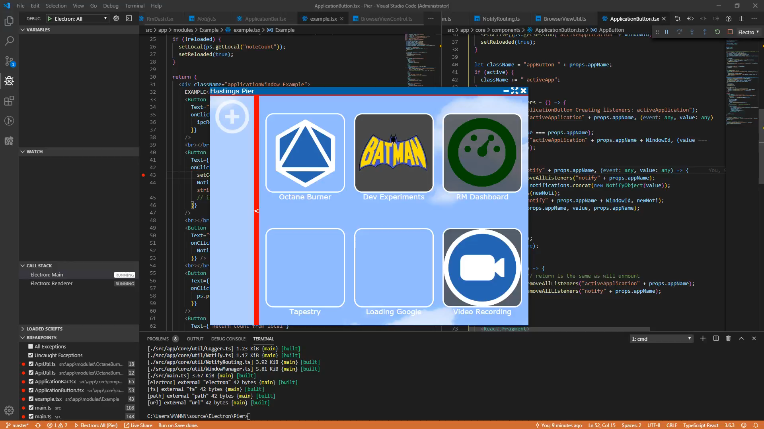
Debugging the app
Notes:
If demo isn’t working, use video.

Slide 12
Testing the app
There are several layers to test
For the UI, main process and the TS backend we have tried JEST
Created by Facebook. Good for JS and TS testing
To perform integration tests Spectron is used.
Spectron is an Electron testing framework which give your tests access to the chromium and electron APIs. Its compatible with webDriver so you can use selenium to drive it.
If you use a different backend language you would need to try a framework suited to that language
Notes:
Spectron - https://electronjs.org/spectron
Having issues getting spectron to run friendly along with JEST but working on that at the moment.

Slide 13
Our experience
Quick to set up*
Simple to create a working application with just HTML and JS
LOTS of node modules
Many react modules available
Pretty popular framework
Cross compatible
Can be challenging to structure nicely
There can be configuration issues depending on what technologies you are trying to get to interact
Easy to deploy
Notes:
LOTS of npm modules for electron specifically to simplify things like deployment, updating applications, debugging and more.
Many react modules available as well for simplifying things.
Many react modules available as well for simplifying things.
Pretty popular framework so plenty of help online with tutorials and stackoverflow. It looks like desktop applications are becoming more and more like web applications
Cross compatible, just need a machine that can run chromium to get most of the functionality.
Sparked a lot of debate about how to structure a electron/React Desktop application
Talk about apps we have built

Slide 14
Hastings Pier
We have started work on the scaffolding for the toolbox application which we are calling “Hastings Pier”
Implemented some core functionality such as:
App switching
Notifications
Saving to Local and persistent storage
Embedding webviews & BrowserViews
While not set in stone we have some design structures we are working to in an attempt to form a standard design for apps to fit into
We have started to set up the testing frameworks needed for each language and created example tests for them.
It’s a learning experience so there almost certainly better ways to implement some things which is where the group effort comes in.

Slide 15
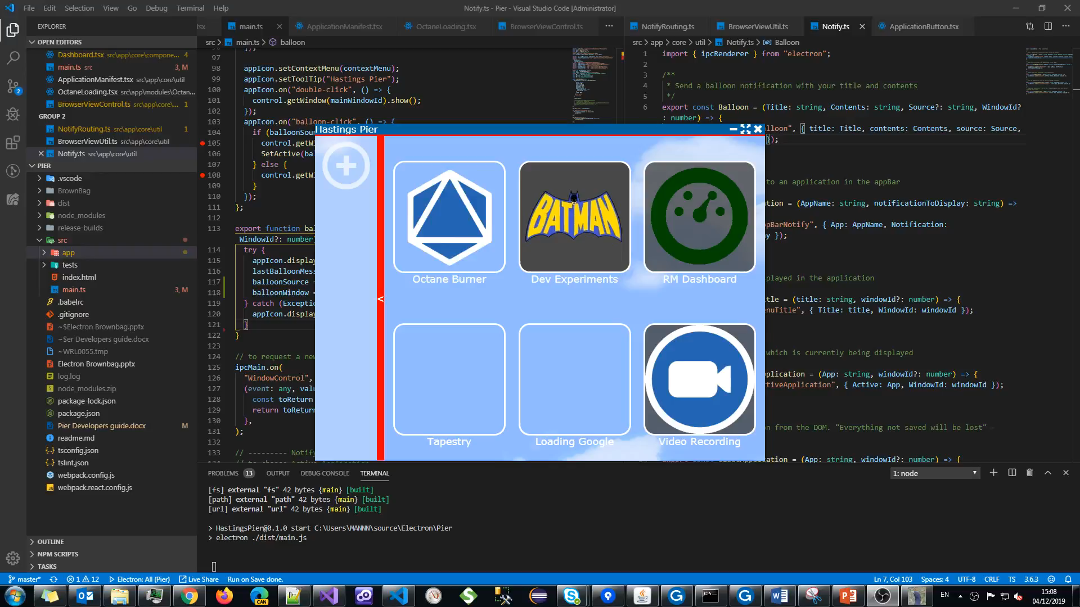
Hastings Pier - Demo

Slide 16
Hastings Pier - Hackathon
For the hackathon we have a few ideas how we want to proceed:
Writing tests for the existing functionality
Improving the core application and getting interested parties up to speed on where we are.
Getting some people to start on building applications/their hackathon ideas within the toolbox.
Design the default look and feel.
There are a few components in the library and all could use styling.

Slide 17
Thank you. Any questions/comments?

